Slide 1


Histogram equalization
Done BY :
Renad mazen
Safeya stati

Slide 2
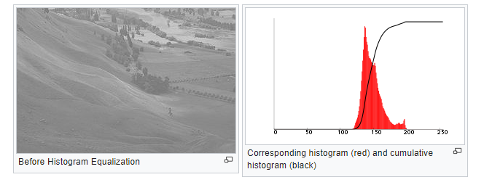
Histogram
A histogram is a graphical depiction of an image's intensity distribution. It simply shows how many pixels are used for each intensity value taken into consideration.

Slide 3
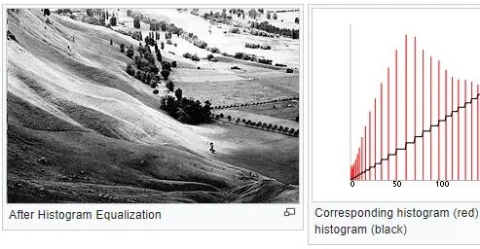
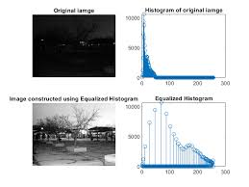
Histogram Equalization
Histogram A computer image processing method called equalisation is used to enhance contrast in pictures. It does this by efficiently extending the image's intensity range, or spreading out the most frequent intensity values. When the useful data of an image is represented by close contrast values, this method typically enhances the global contrast of the image. This makes it possible for regions with less local contrast to become more contrasty.

Slide 4
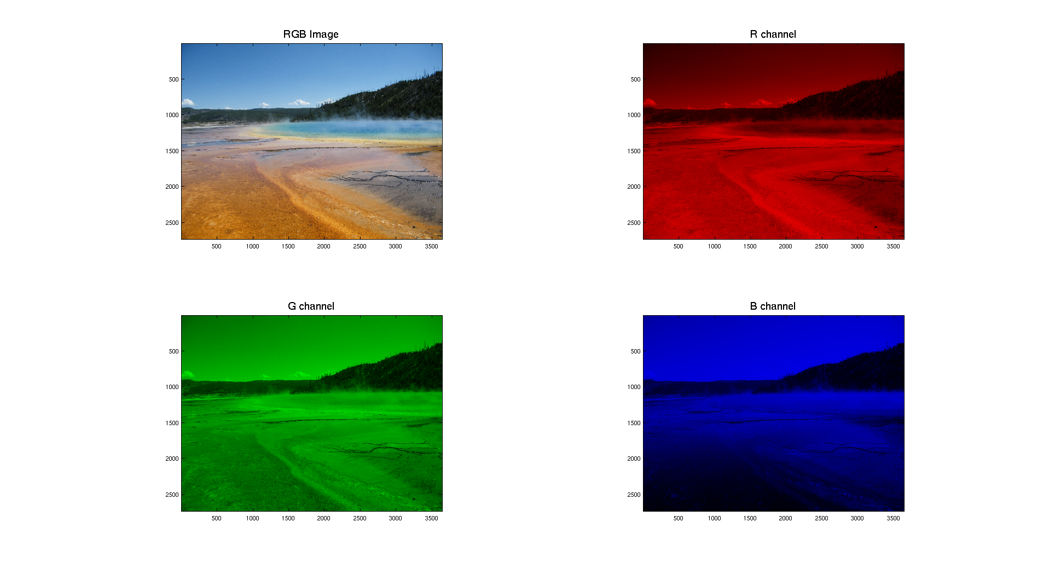
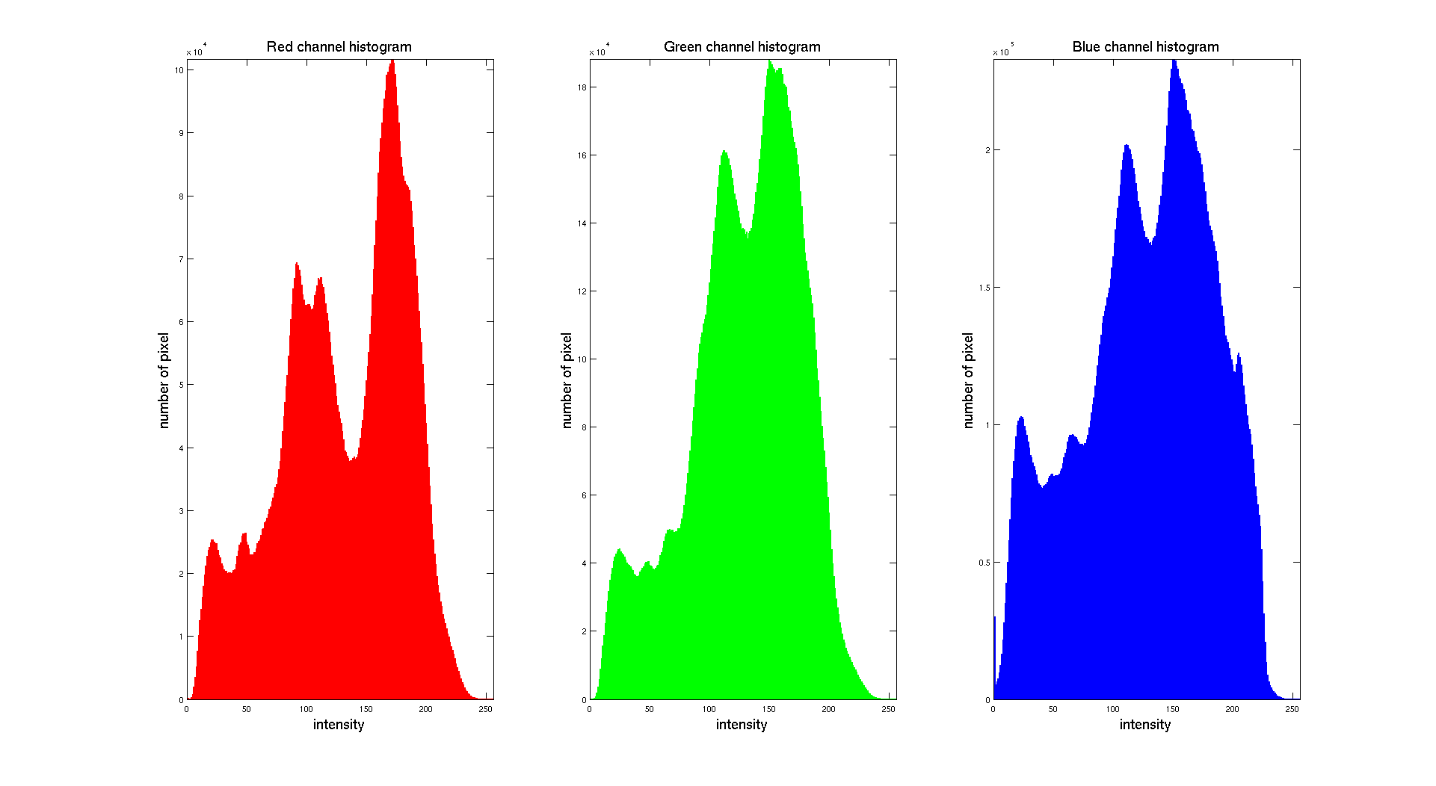
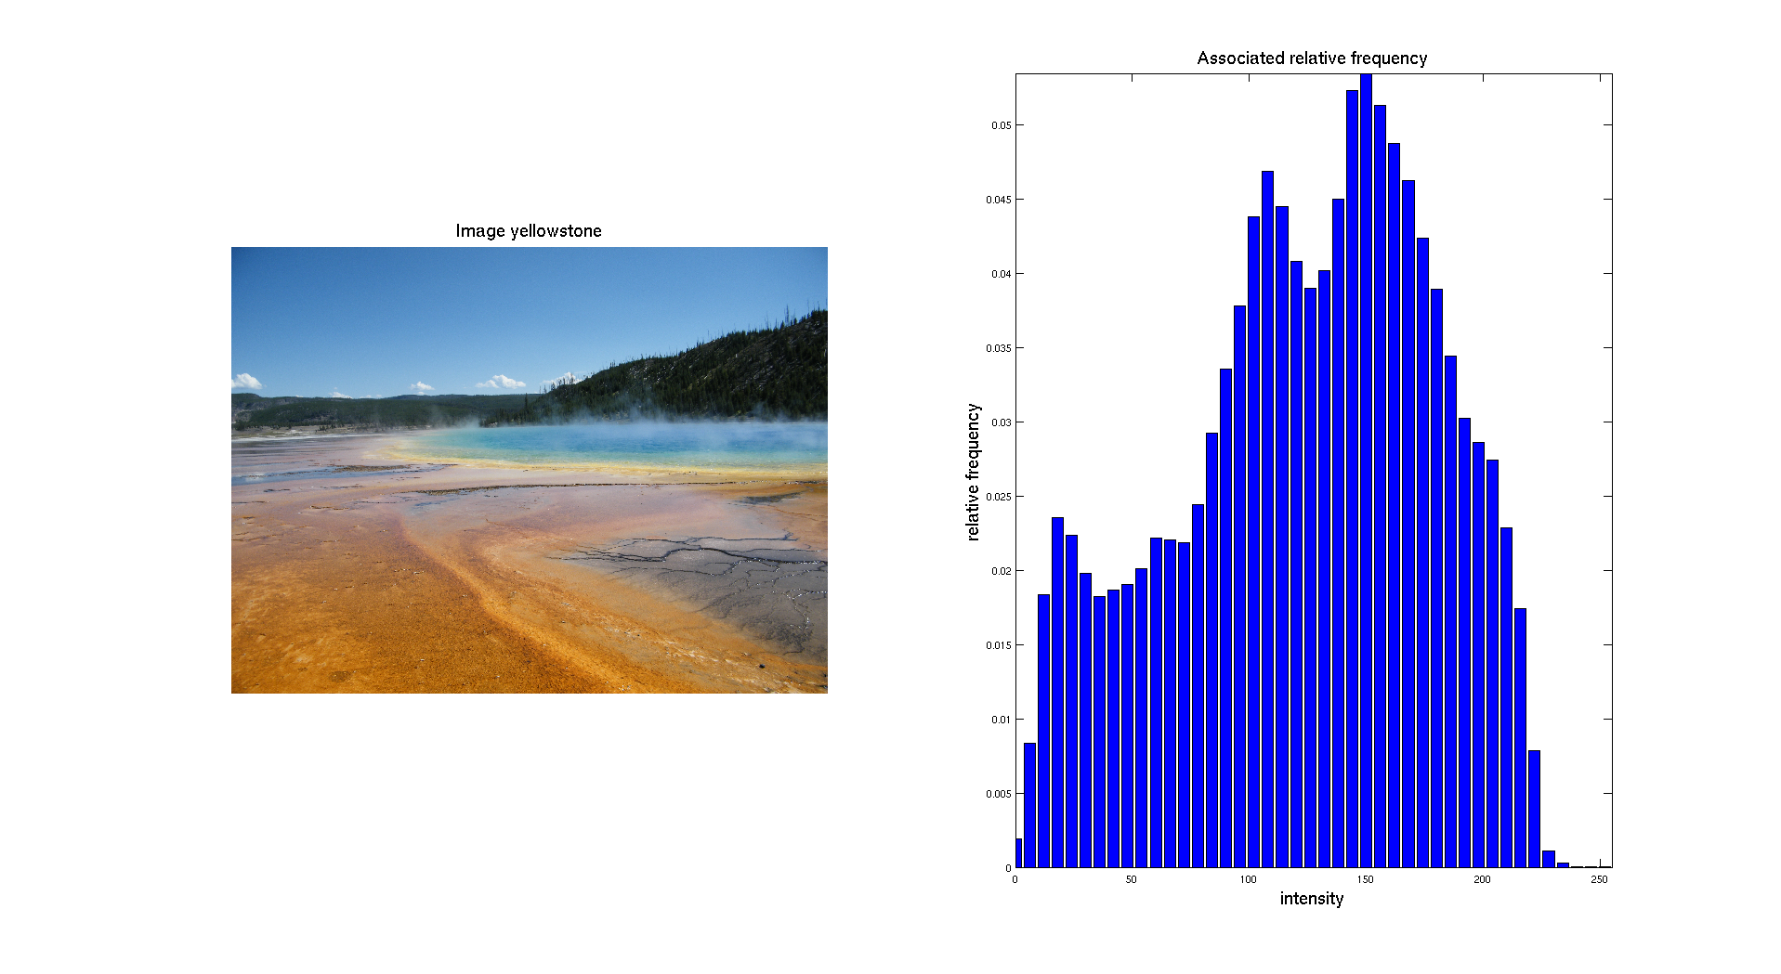
Color image
We can also give as input a digital color image. Then the first thing to do is to separate the three different color channels: Red, Green and Blue.

Slide 5
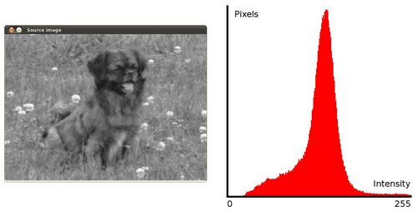
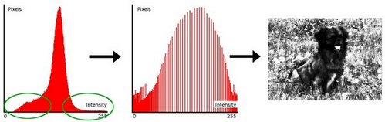
problem
In some images, it would not have been better to implement the code on them

Slide 6
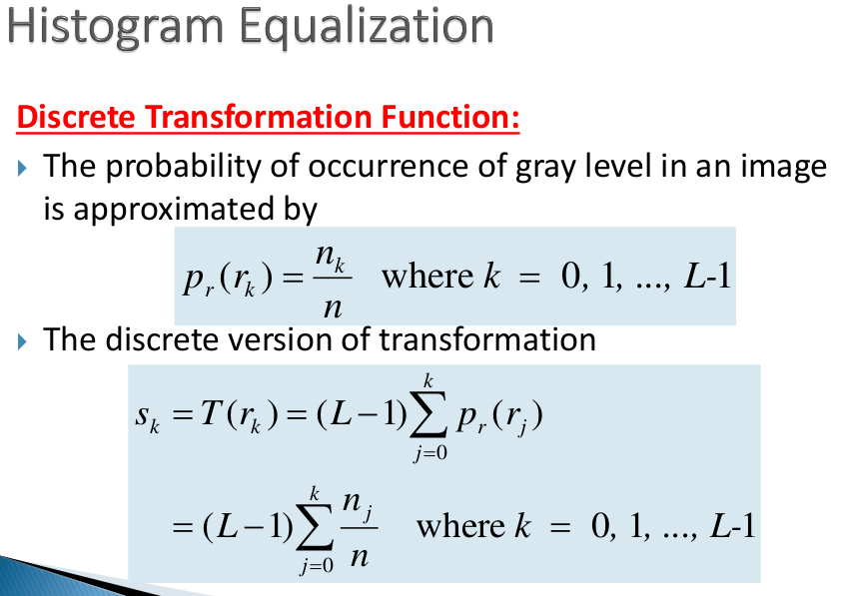

Slide 7
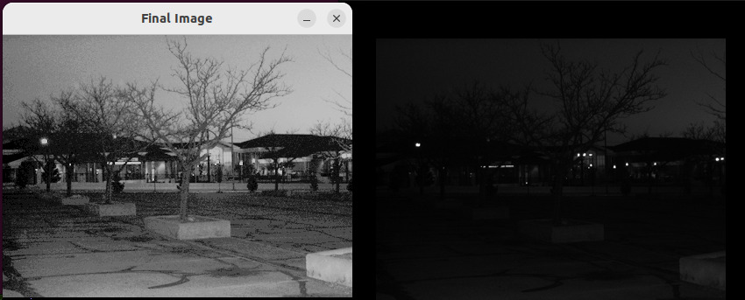
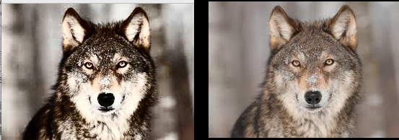
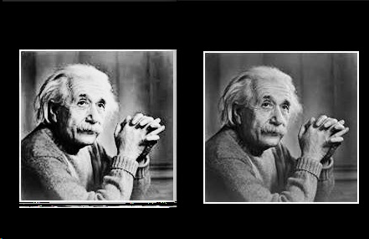
In serial :
Pic1 dim 399*300
Pic2 dim 267*189
Pic3 dim 182*186

Slide 8
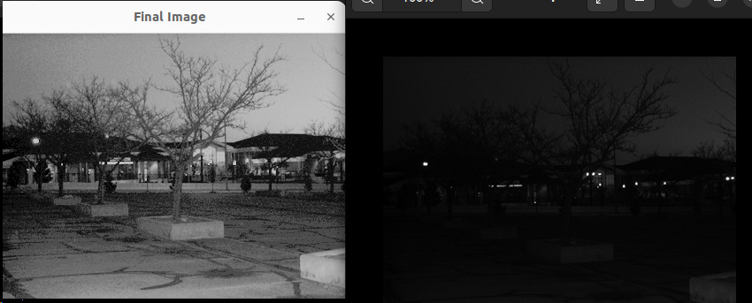

In omp :
pic1
pic2
pic3

Slide 9
In coda :
Pic1
pic2
pic3

Slide 10
Cpu time
pic | Cpu time serial | Cpu time omp | Cpu time cuda
Pic1 dim 399*300 | 0.012634 | 0.00399976 | 0.00188670
pic2Pic2 dim 267*189 | 0.025225 | 0.0145094 | 0.099236
Pic3 dim 182*186 | 0.025891 | 0.00816066 | 0.00618524

Slide 11
Conclusion
To conclude this first project, we can say that we had the opportunity to implement the basic functions of Image Processing. We worked on histograms which are the best tool to understand the distribution of an image intensities.
The part about the equalization showed us how to enhance the contrast of a dark image but also showed us that sometimes if the histogram is already distributed on all the range of levels, the enhancement is not very effective.

